Slide 1
Discovering the Best Location for a New Restaurant in Downtown Toronto Neighborhoods
ADEDAMOLA ADEDOKUN

Slide 2
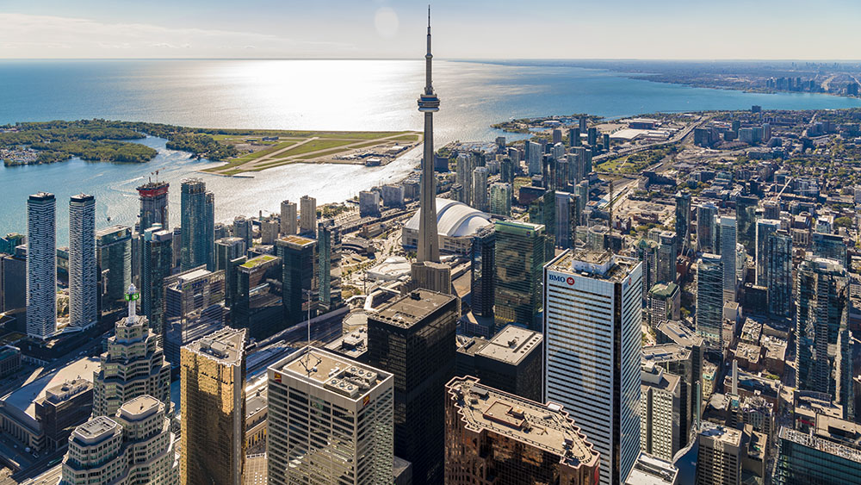
INTRODUCTION
Largest city in the country with a diverse population
Key locations for business is important for restaurant business success.
Information valuable for business owners and entrepreneurs

Slide 3
Data Acquisition and Cleaning
Toronto postal codes data was scraped from the Wikipedia website https://en.wikipedia.org/w/index.php?title=List_of_postal_codes_of_Canada:_M. Geographical coordinates of each postal code from : http://cocl.us/Geospatial_data
Only records with an assigned Boroughs were used, others were left out.
Cleaned data contained 10 Boroughs and 103 Neighborhoods.
Data scraped / downloaded were combined into one table.

Slide 4
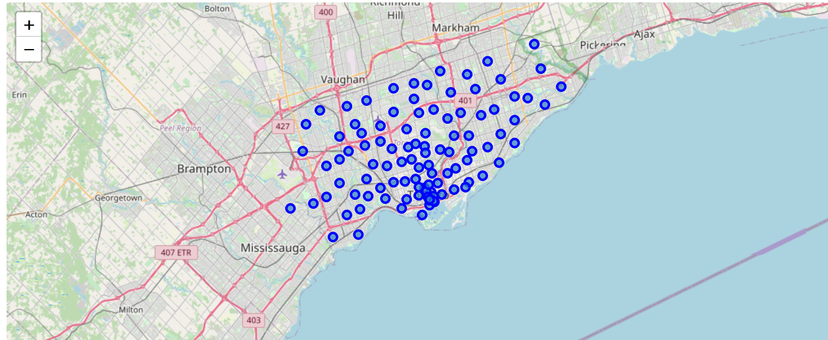
Neighborhoods in Toronto
Toronto map with its Neighborhoods

Slide 5
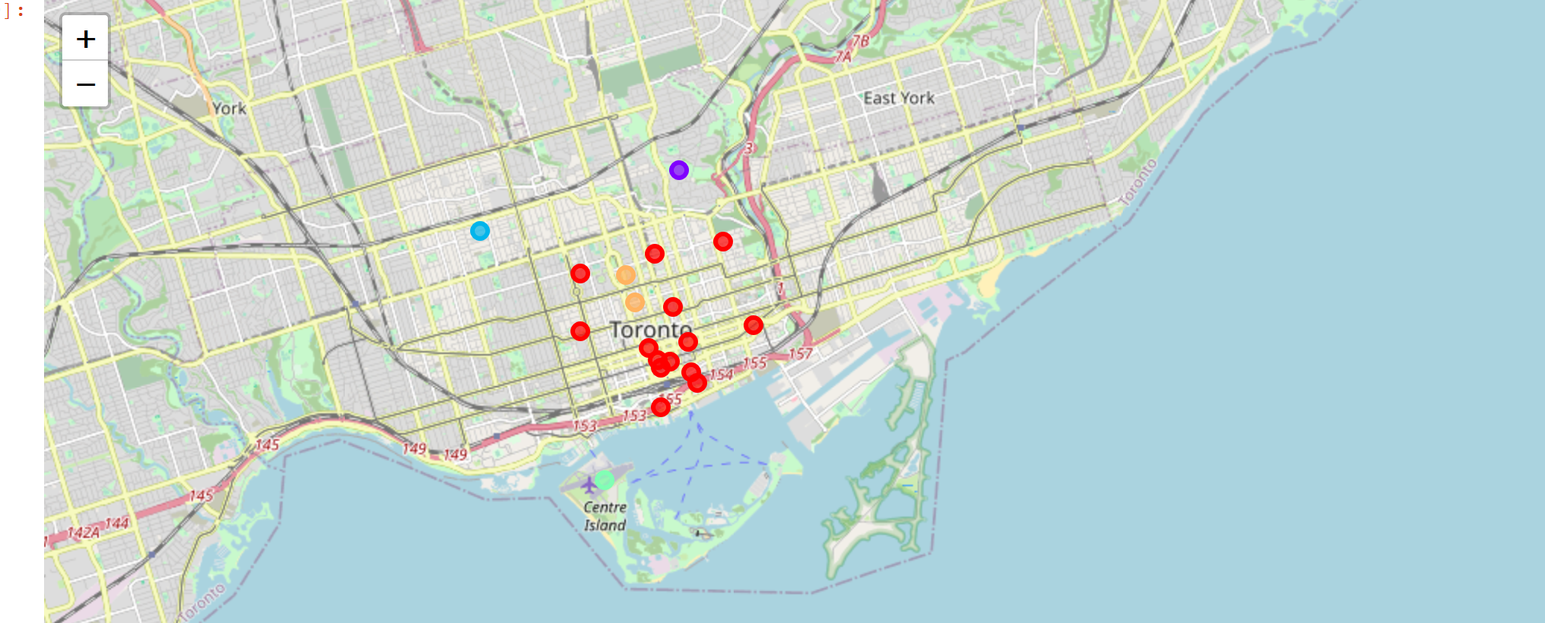
Neighborhoods in Downtown Toronto
The red dots are mainly filled with lots of social venues, cafes and restaurants.
The yellow dots are areas also with coffee shops and some restaurants.
The purple dots are park related areas for outdoor activities.
The sky blue dots are areas with grocery stores and some social venues.
The light green dots are the areas related to transportation and city airport.
Visual representation of Neighborhood clusters on Toronto map

Slide 6
CONCLUSION
Built useful models to cluster similar Neigborhoods in Downtown Toronto.
Accuracy of the models has room for improvement.
Data set can be expanded and the details of the neighborhood or street can also be explored in other parts of the city.

